Slide 1

Explaining Prosecution Outcomes for Cryptocurrency-Based Financial Crimes
Centre for Doctoral Training in Cybersecurity
Department of Security and Crime Science
Arianna Trozze | Information Security Seminar Series | 26 November 2020

Slide 2
Research Context
Research
Question
Financial crime involving cryptocurrencies
U.S. government prosecutions in their infancy
Usefulness of existing predicate offences
What factors are associated
with successful U.S.-based cryptocurrency financial crime prosecutions?

Slide 3
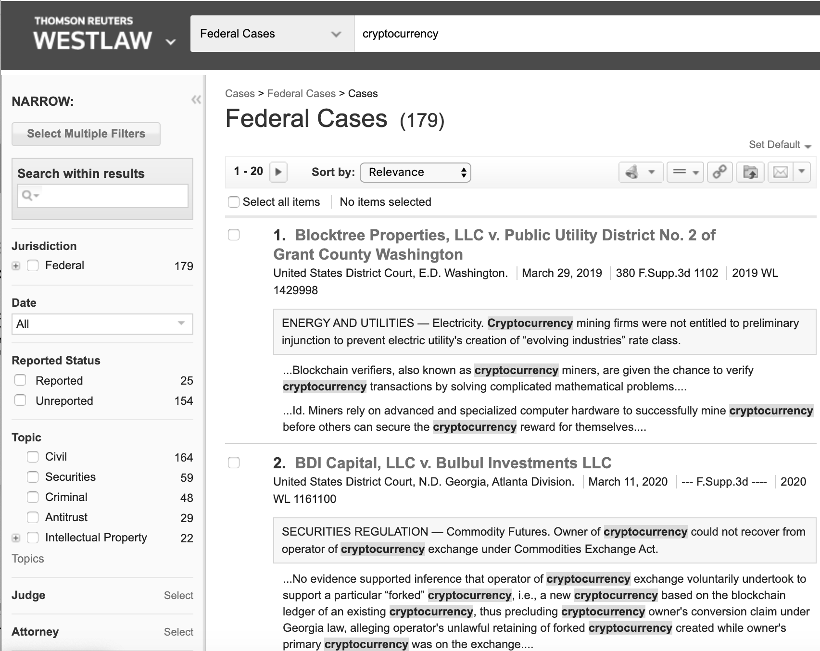
Method
1. Search using Westlaw
2. Extract all cases involving financial crime offence and cryptocurrencies
3. Cross-reference with
agency press releases
and prior research

Slide 4
Coding Framework
Variable | Code | Where to Find
Dependent
Disposition | 0= Voluntary dismissal 1= Settlement 2= Jury trial 3= Bench trial 4= Default or summary judgment 5= Guilty plea | Docket
Sentence (criminal) | 0= non-custodial 1= custodial | Judgment, sentencing order
Monetary penalty (civil) | 0= Not alleged in complaint 1= restitution + disgorgement is less than alleged in complaint (excluding interest) 2= restitution + disgorgement is equal to amount alleged in complaint (excluding interest) 3= restitution + disgorgement is greater than amount alleged in complaint (excluding interest) | Judgment, forfeiture order, restitution order
Independent
Offence characteristics
Charges | 0= one count 1= two to five counts 2= six to ten counts 3= eleven or more counts | Complaint, indictment, information
Variable | Code | Where to Find
Wire fraud charged? (criminal) | 0= wire fraud not charged 1= wire fraud charged | Complaint, indictment, information
Cryptocurrency involved | 0= other coin only or unspecified 1= Bitcoin involved | Complaint, indictment, information
Defendant characteristics
Number of defendants | 0= one defendant 1= two to five defendants 2= six or more | Complaint, indictment, information
Individual or corporate | 0= individual defendant only 1= presence of corporate defendant | Complaint, indictment, information
Evidence characteristics
Witness evidence | 0= no witnesses 1= witness evidence | Exhibits, judgment, appeal opinion, docket
Forensic evidence | 0= qualitative evidence presented only 1= quantitative evidence presented | Exhibits, judgment, appeal opinion, docket
Additional evidence | 0= information in charging document is only evidence filed 1= additional evidence filed | Exhibits, judgment, appeal opinion, docket

Slide 5
Final dataset
Initial Search: 483 cases
Removal of Ineligible Cases: Removed duplicates, cases that did not involve financial criminal offence, in rem cases, or where decision had not been reached by 1 May 2020
Set of Cases (for IRR): Initial set of 50 cases
Final Set: After more detailed data
extraction, final set of 37 cases

Slide 6
Inter-coder reliability
Additional Coders: Two people coded 10 cases each
Fleiss’ Kappa: 0.791, p < .0001
High level of agreement

Slide 7
Note: Numbers in the darker boxes are the codes you should put in the spreadsheet based on the answers to the questions, which you can answer chronologically
1. Examine the complaint/ indictment/ information. If a superseding document was filed, use the latest one.
6. Were the defendants individuals or companies?
4. What cryptocurrency was involved?
2. How many counts were charged?
3. Was wire fraud charged?
Other coin(s) only or unspecified
Bitcoin
No
Yes
5. How many defendants were there?
Individual(s) only
At least one corporate defendant
1
2-5
6-10
> 11
0
1
0
1
2
3
0
1
1
2-5
> 6
7. Examine the docket
0
1
2
0
1
9. Examine the judgment, sentencing order, restitution order, and/or forfeiture order. If a superseding one of any of them was filed, use the latest one.
8. How was the case disposed?
Default/ summary judgment
Guilty plea
Voluntary dismissal
Jury trial
Bench trial
Settlement
16. Was any additional evidence filed after the complaint/ indictment/ information?
0
1
2
3
4
5
10. Was it a criminal case?
13. Examine any exhibits, the judgement, and any appeal opinion.
Yes
No
14. Was witness evidence provided (in the form of a declaration, live testimony, or deposition, for example)?
15. Was any quantitative evidence filed (i.e. bank statements, analyses of fund flows, etc.)?
12. How much was disgorgement + restitution?
No
Yes
11. Was a custodial sentence imposed?
Greater than amount alleged in complaint
0
1
Not alleged in charging document/ complaint
Less than amount alleged
No, only qualitative evidence was filed (i.e. emails, website screenshots, white papers).
Equal to amount alleged
No
Yes
No
Yes
Yes
0
1
0
1
2
3
0
1
0
1

Slide 8
Results

Slide 9
Fisher’s Exact Test
Criminal Cases
Independent Variable | Disposition (p-value) | Sentence (p-value)
Charges | 0.103 | 0.608
Wire Fraud | 1 | 0.405
Cryptocurrency | 1 | 1
Defendants | 1 | 0.497
Type of Defendant | 1 | 1
Witness Evidence | 0.025 | 0.098
Forensic Evidence | 0.025 | 0.098
Additional Evidence | 0.069 | 0.183
All Cases
Independent Variable | Disposition (p-value)
Charges | 0.004
Cryptocurrency | 0.010
Defendants | 0.036
Type of Defendant | <0.001
Witness Evidence | 0.057
Forensic Evidence | 0.089
Additional Evidence | 0.184
Civil Cases
Independent Variable | Disposition (p-value) | Penalty (p-value)
Charges | 0.008 | 0.830
Cryptocurrency | 0.055 | 0.426
Defendants | 0.653 | 0.103
Type of Defendant | 1 | 0.678
Witness Evidence | 1 | 0.666
Forensic Evidence | 0.860 | 0.251
Additional Evidence | 0.714 | 0.666

Slide 10
Logistic Regression
Disposition |  | Std. Error | Sig. | Exp(B)
Trial | Intercept | 8080.672 | .998
 | Charges: low (one to three counts) | 11031.324 | .997 | 2.404E-17
 | Cryptocurrency: other coin only or unspecified | .000 | . | 6.533E-18
 | Number of defendants: one defendant | 1.805 | .553 | 2.914
 | Type of defendant: individual defendant only | 8080.672 | .998 | 7.833E-10
 | Forensic evidence: qualitative evidence presented only | 7509.518 | .998 | 61232857.850
 | Additional evidence: information in charging document is only evidence filed | .000 | . | 2.612E-17
Summary judgment or default judgment | Intercept | 1.910 | .180
 | Charges: low (one to three counts) | 1.632 | .685 | .516
 | Cryptocurrency: other coin only or unspecified | 1.399 | .078 | .085
 | Number of defendants: one defendant | 1.973 | .670 | 2.319
 | Type of defendant: individual defendant only | 2.025 | .035 | .014
 | Forensic evidence: qualitative evidence presented only | 1.898 | .522 | .297
 | Additional evidence: information in charging document is only evidence filed | 1.823 | .719 | .520
Effect of Independent Variables on Disposition: Aggregated Number of Charges (low or high),
Number of Defendants (one or more than one), and
Disposition (trial; summary/default judgment; or guilty plea or settlement) (last categories as reference categories)

Slide 11
Key Findings
All cases: # of charges, cryptocurrency, # of defendants, and type of defendants each associated with disposition
All cases: Presence of individual (not corporate) defendants made case less likely to be resolved by summary or default judgment
Criminal cases: Witness and forensic evidence associated with disposition
Civil cases: # of charges associated with disposition

Slide 12
Disposition and Penalties
Consistent with fact that almost all U.S. criminal convictions obtained by guilty plea
Overcharging and sentencing guidelines incentivise guilty pleas
Charges
Evidence of horizontal overcharging
Types of charges were surprising
Discussion

Slide 13
Cryptocurrency
Cases primarily involved Bitcoin or scam tokens
Almost no cases involved other popular cryptocurrencies
Defendants
Results consistent with research that co-defendants did not impact conviction rates
Presence of individual defendant made a case less likely to be resolved by summary / default judgment
Discussion

Slide 14
Evidence: Primarily qualitative evidence—emails, texts, screenshots of websites, marketing materials, Tweets
Blockchain evidence: Debate about admissibility
Witness evidence: Expert witness testimony to validate blockchain evidence?
Additional evidence: Unnecessary or coerced guilty pleas?
Discussion

Slide 15
Limitations
Small population
U.S. cases only and various federal courts
COVID case delays
Basic data extracted
Civil and criminal analysed together

Slide 16

Variables: More granularity in variables extracted or additional factors
Cases: Expand to all financial crime cases or private civil cases
Evidence: Further research into quantitative evidence, automating collection, cost/benefit analysis, jury handling of blockchain evidence
Future Research

Slide 17
Questions?
Thank
You!
arianna.trozze@ucl.ac.uk

